Slide 1


Slide 2






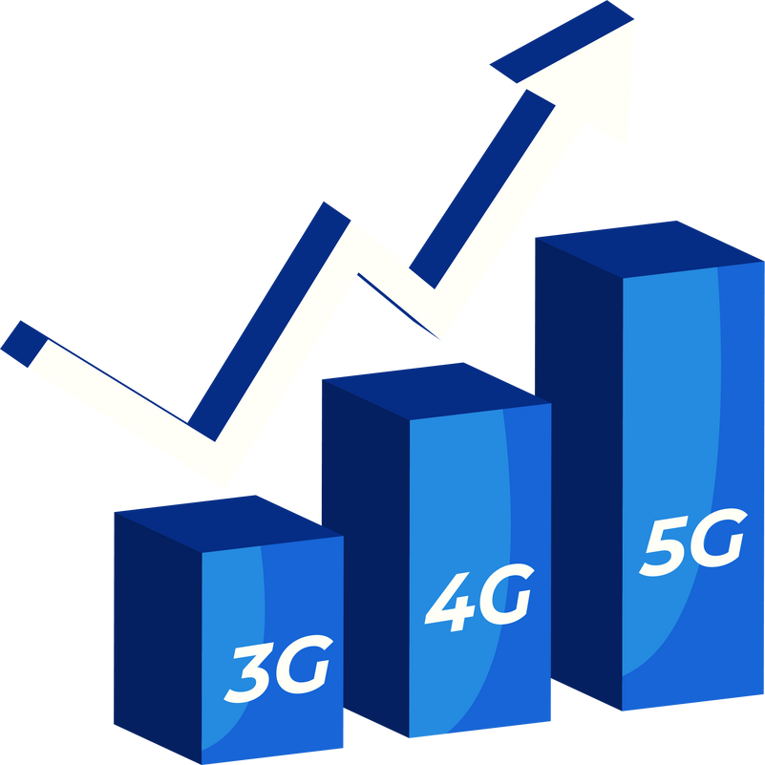


Integrated Program in Business Analytics
Telco Customer Churn
IPBA_B17: Group_F
Mentor : Mr. Ashish Mishra

Slide 3








Participants:
Mr. Dilip Meher
Ms. Dipanwita Das Chakrabarty
Ms. Sweta Dixit
Mr. Shobhit Sharan
Mr. Sudhanshu Mittal
Ms. Suchismita Dash
Mr. Gaurav Maheshwari

Slide 4
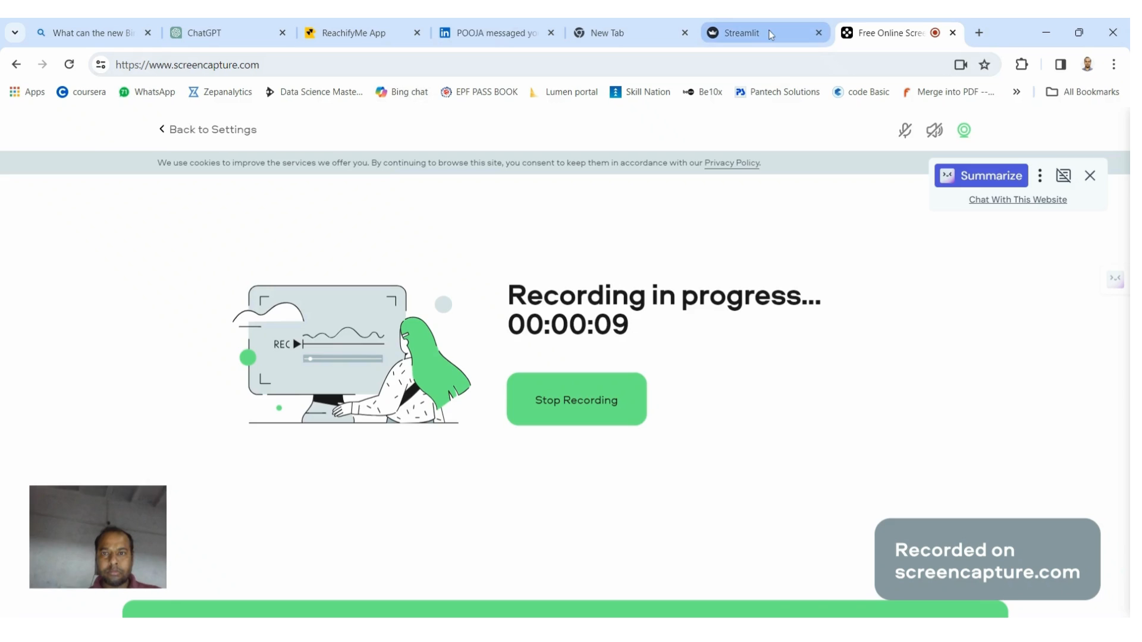
Model: Churn.. Turn… Fun….
4

Slide 5



Agenda
Business Problem and Objectives
Executive Summary
Data Overview and Key Business Assumptions
Data Preparation and Pre-processing
Sanity checks, treatment and transformations for analytical dataset preparation
Exploratory Data Analysis
Key Business Findings and Insights
Model Development and Validations
Model comparisons on key scoring metrics and model finalization
Business Recommendations and Potential Business Impact
ML Model Deployment
Appendix
© 2021 Jigsaw Academy Education Pvt Ltd.
5

Slide 6
Project lifecycle
Define the Problem
Customer Churn
Collect and Prepare Data
Dataset contains information of customer using Telcom services
Feature Engineering
Feature Scaling
Test and Refine Machine Learning Model
Machine Learning Prediction Service
Manage Prediction Service & Model Deployment
Train test split of data
After Comparison of different model selected the Best model for the Deployment
EDA
Data has been Analyzed using Visualization methods to prepare the Model Building
One Hot Encoding
Use of Different Machine learning models to get the best one to reduce the churn rate
Label Encoding
6

Slide 7
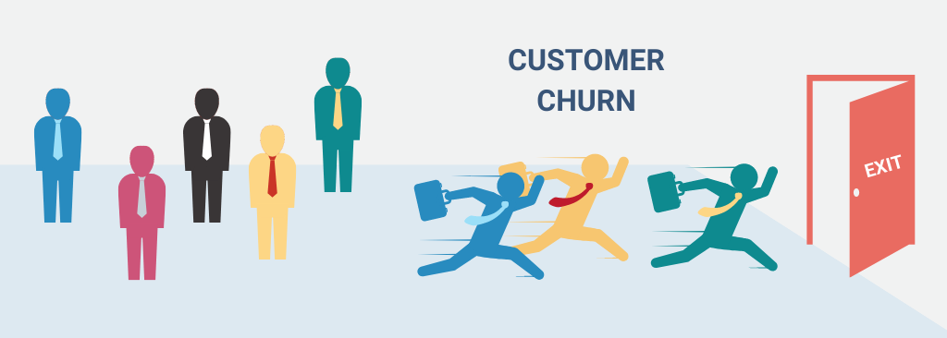
Executive Summary
“Customer churn, when customers leave a company, is a big problem for Telecom companies, happening about 15-20% each year. To tackle this, we need to understand why customers leave. We're using a special set of data to figure out why customers leave phone companies and try to predict when it might happen. Our goal is to make plans that will keep customers happy and working together as a team to keep them with us
© 2021 Jigsaw Academy Education Pvt Ltd.
7

Slide 8

Business problem
The Telecom company competition is Challenging, with lots of choices for customers. Because of this, the phone companies have a hard time keeping their customers, with about 15-20% leaving each year. This is a big problem because it costs a lot more money to get new customers than to keep the ones they already have.
Key Objectives
Identifying why customers Leave
Measuring the customer loss
Predicting customer actions
Creating customer loyalty programs
Effective communication with customers
Teamwork across departments
© 2021 Jigsaw Academy Education Pvt Ltd.
8

Slide 9



Data Understanding/Data Dictionary
Classification Label
Churn — Whether the customer churned or not (Yes or No)
Service type
Internet Service — A type of internet service the customer has (DSL, Fiber Optic, No)
Online Security — Whether the customer has online security or not (Yes, No, No Internet Service)
Online Backup — Whether the customer has online backup or not (Yes, No, No Internet Service)
Device Protection — Whether the customer has device protection or not (Yes, No, No Internet Service)
Tech Support — Whether the customer has tech support or not (Yes, No, No Internet Service)
Streaming TV—Whether the customer has a streaming TV (Yes, No, No Internet Service)
Streaming Movies — Whether the customer has a streaming movie (Yes, No, No Internet Service)
Phone Service - Whether the customer has a phone service or not (Yes, No)
© 2021 Jigsaw Academy Education Pvt Ltd.
9

Slide 10
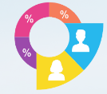



Data Understanding/Data Dictionary
Customer Demographic information
Customer-ID — Unique value for each customer
Gender — The type of gender each customer (Female, Male)
Senior-Citizen — Whether the customer is a senior citizen (Yes, No)
Partner — Whether the customer has a partner or not (Yes, No)
Dependents — Whether the customer has a dependent or not (Yes, No)
Customer Account Information
Tenure — How long customer has stayed in the company
Contract — The type of contract the customer has (Month-to-Month, One year, Two years)
Paperless Billing — Whether the customer has a paperless billing (Yes, No)
Payment Method — payment method used by the customer (Electronic check, Mailed check, Bank transfer (automatic), Credit card (automatic))
Monthly Charges — Amount charged to the customer monthly
Total Charges — The total amount charged to the customer`
© 2021 Jigsaw Academy Education Pvt Ltd.
10

Slide 11
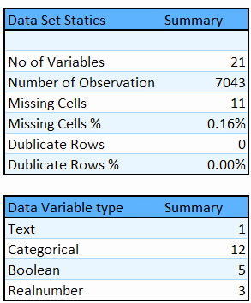

Data Overview
Telco customer Data set
SOURCE : KAGGLE
https://www.kaggle.com/datasets/blastchar/telco-customer-churn
© 2021 Jigsaw Academy Education Pvt Ltd.
11

Slide 12
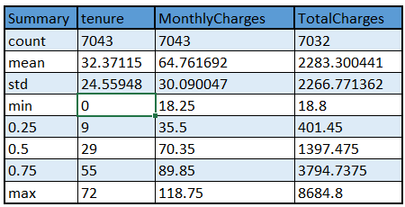
Data Overview
Summary Statistics
75% customers have tenure less than 55 months
Average Monthly charges are USD 64.76 whereas 25% customers pay more than USD 89.85 per month
© 2021 Jigsaw Academy Education Pvt Ltd.
12

Slide 13
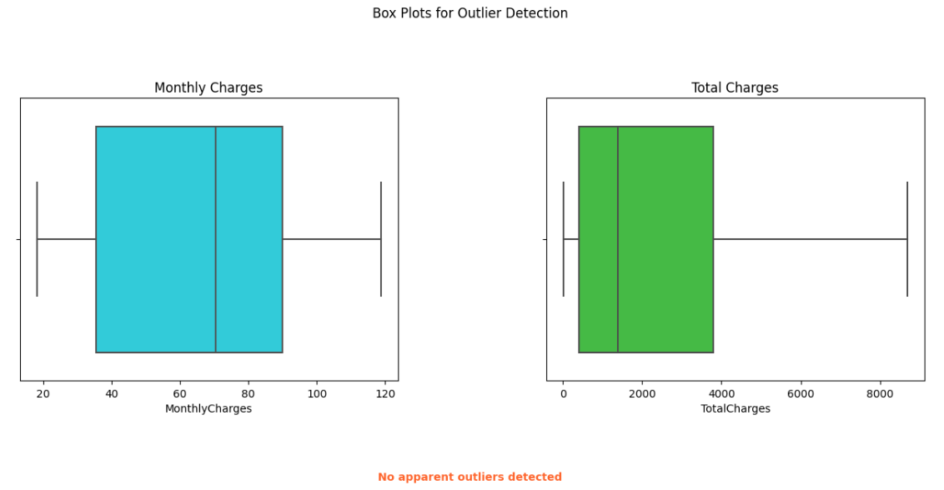
Data Overview
Outlier detection and treatment
There is no Outlier detected in Monthly charges as well as Total charges
© 2021 Jigsaw Academy Education Pvt Ltd.
13

Slide 14
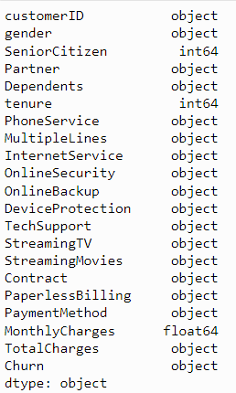
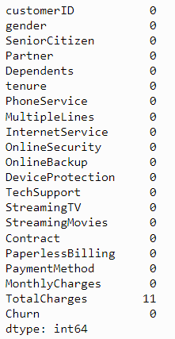
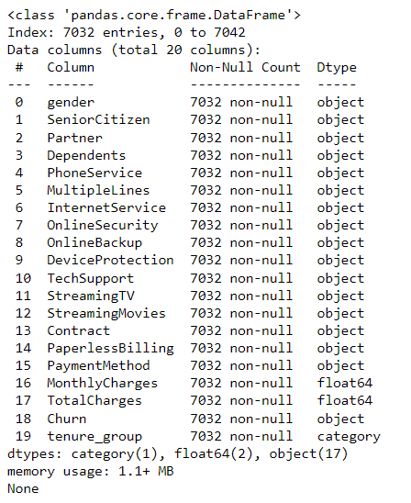
Data Overview Before Treatment
Data Overview After Treatment
Data types
Missing value
© 2021 Jigsaw Academy Education Pvt Ltd.
14

Slide 15
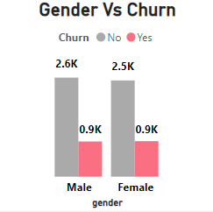
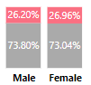
Exploratory Data Analysis (EDA) - Univariate
Customer Demographic- Gender
Findings :-
The percentage of churned and active customers is almost equal for both genders.
Approximately 26% of male customers and 27% of female customers churned.
Gender has little impact on customer churn.
Insight :Gender of Customer does not play a significant role in predicting the Churn Rate. Additional Factors Should be consider for more comprehensive analysis of Churn.
© 2021 Jigsaw Academy Education Pvt Ltd.
15

Slide 16
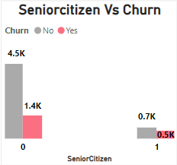
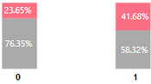
Exploratory Data Analysis (EDA) - Univariate
Customer Demographic- Senior citizens
Findings :-
Senior Citizens:
Churn rate: 41.7%
This group experiences a relatively higher churn rate compared to other age groups.
Non-senior Citizens:
Churn rate: 23.7%
Non-senior citizens exhibit a significantly lower churn rate.
Insight :Most of the senior citizens are under a monthly service plan, which could be due to financial reasons.
© 2021 Jigsaw Academy Education Pvt Ltd.
16

Slide 17
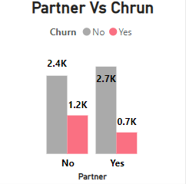
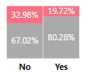
+3.
.
Exploratory Data Analysis (EDA) - Univariate
Customer Demographic- Partner
Findings :-
Found 20% Churn rate in customer with partner and 33% churn rate in customer without-partner.
Customers without a partner are churning more compared to customers with a partner.
Insight :Customers with partners may exhibit different patterns of usage, loyalty, and satisfaction compared to those without partners.
© 2021 Jigsaw Academy Education Pvt Ltd.
17

Slide 18
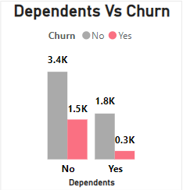
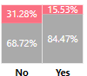
Exploratory Data Analysis (EDA) - Univariate
Customer Demographic- Dependents
Findings :-
Found 31% Churn rate in customer with out Dependents and 15.5% churn rate in Customer with Dependent
Customers without dependents are churning more compared to customers with dependents.
Insight :Customers with dependents may have different usage patterns, preferences, and loyalty compared to those without dependents as well as Customer without dependents having their own source of income have they are prone to churn
© 2021 Jigsaw Academy Education Pvt Ltd.
18

Slide 19
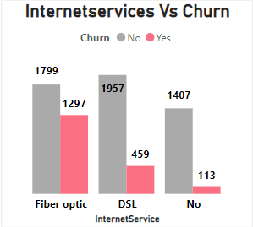
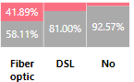
Exploratory Data Analysis (EDA) - Univariate
Customer Service Type- Internetservices
Findings :-
Customers with fiber optic internet service have the highest churn rate, at 41.9%.
DSL (Digital Subscriber Line) customers experience a churn rate of 19%.
Customers who do not have internet service face a lower churn rate of 7.4%
Insight : Fiber Optic
Speed Expectation: Eventhough Fiber Optic promises blazing fast speeds, but if the actual performance falls short, customers may become dissatisfied and switch providers.
Installation Challenges :Installing fiber optic infrastructure can be complex and time-consuming. Delays or issues during installation can frustrate customers.
Price Sensitivity: Fiber optic tends to be more expensive. If customers perceive that the cost outweighs the benefits, they might churn.
DSL:- Digital Subscriber line may be outdated , Slow speed and Frequent disruption and inadequate technical support for DSL
© 2021 Jigsaw Academy Education Pvt Ltd.
19

Slide 20
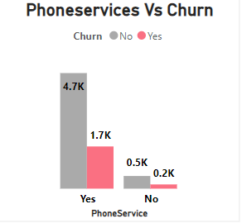
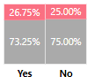
Exploratory Data Analysis (EDA) - Univariate
Customer Service Type- Phoneservices
Findings :-
The churn rate for customers with phone services is 26.7% as well as The churn rate for customers without phone services is 25%.
Customers without phone service exhibit a substantially lower churn rate.
Insight :
The presence or absence of Phone Service alone may not be a strong predictor of customer churn, but it is a noteworthy predictor of customer churn.
© 2021 Jigsaw Academy Education Pvt Ltd.
20

Slide 21
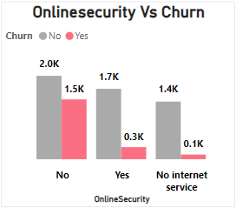
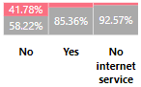
Exploratory Data Analysis (EDA) - Univariate
Customer Service Type- Onlinesecurity
Online security services typically include features like antivirus protection, firewall, and secure browsing aim to safeguard customers’ data, privacy, and online activities
Finding :-
Customers with No online security have the highest churn rate, at 42%.
The absence of Online security services associated with high churn rate
Insight : Most of these customers which don’t have Onlinesecurity service fall under the Monthly contract type which is flexible of exit as well as not dependent .
© 2021 Jigsaw Academy Education Pvt Ltd.
21

Slide 22
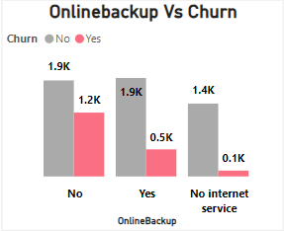
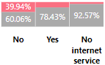
Exploratory Data Analysis (EDA) - Univariate
Customer Service Type- Online backup
Finding :-
Customers with No online backup have the highest churn rate, at 40%. The absence of online backup services associated with higher churn rate
Insight : The telecommunications company should consider promoting the benefits of online backup to customers as part of a strategy to potentially reduce churn rates.
© 2021 Jigsaw Academy Education Pvt Ltd.
22

Slide 23
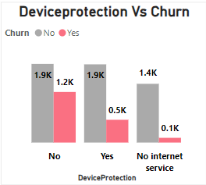
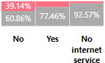
Exploratory Data Analysis (EDA) - Univariate
Customer Service Type- Device protection
Finding :-
Customers with No device protection have the hi churn rate, at 39%. the absence of Device Protection is associated with higher customer churn.
Insight : It's important for the telecommunications company to consider strategies to encourage customers to opt for device protection services to potentially reduce churn rates.
© 2021 Jigsaw Academy Education Pvt Ltd.
23

Slide 24
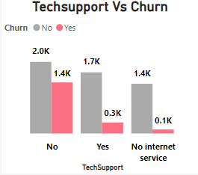
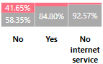
Exploratory Data Analysis (EDA) - Univariate
Customer Service Type- Tech Support
Finding:-
Customers with No Techsupport have the high churn rate, at 41.6%. The absence of Tech support is associated with higher customer churn.
Insight : The telecommunications company should explore strategies to enhance tech support offerings to potentially reduce churn rates.
© 2021 Jigsaw Academy Education Pvt Ltd.
24

Slide 25
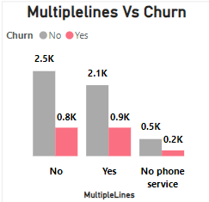
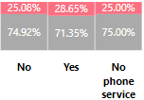
Exploratory Data Analysis (EDA) - Univariate
Customer Service Type- Multiplelines
Findings :-
Customers with Single lines have the churn rate, at 25%. Customers with multiple lines have churn rates at 28.6% and No phone services have 25% churn rate.
Insight : Customers with multiple lines might not experience varying churn rates as significantly as those with a single line. Further analysis is needed to determine the impact.
© 2021 Jigsaw Academy Education Pvt Ltd.
25

Slide 26
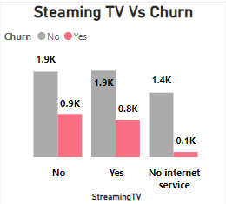
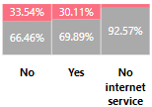
Exploratory Data Analysis (EDA) - Univariate
Customer Service Type- Steaming TV
Findings :-
Customer having Steaming tv subscription and with out subscription having almost similar churn rate 30% & 33.5% respectively.
Insight : The availability of Streaming TV services alone may not significantly influence customer churn. Further analysis considering additional factors is recommended to better understand the predictors of customer churn in the context of streaming TV services.
© 2021 Jigsaw Academy Education Pvt Ltd.
26

Slide 27
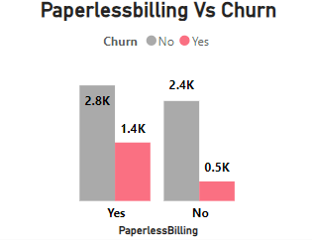
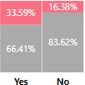
Exploratory Data Analysis (EDA) - Univariate
Account information- Paperless-billing
Findings :-
Customer having paperless billing having the churn rate at 33.6% . Customers who use Paperless Billing are churning more in comparison to their counterparts .
Insight :
Paperless billing are lack of personal touch, billing transparency issue, digital fatigue and preference of simplicity. Customer with paperless billing target as autopayment which leads to more churn.
© 2021 Jigsaw Academy Education Pvt Ltd.
27

Slide 28
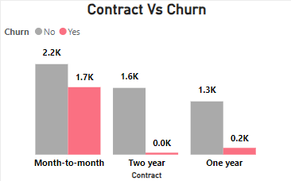

Exploratory Data Analysis (EDA) - Univariate
Account information- Contract
Findings :-
Customers with different contract types exhibit varying churn rates. Month to Month contract having highest Churn rate . There is 43% Churn rate in Month-to-Month Contract
Insight : Because Month to month contract have high monthly charges as compared to one year and two-year contract. As month-to-month contract has more flexi so it is more prone to churn
© 2021 Jigsaw Academy Education Pvt Ltd.
28

Slide 29
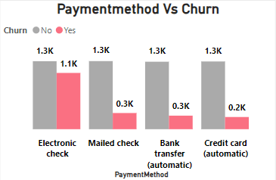
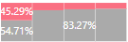
Exploratory Data Analysis (EDA) - Univariate
Account information- Payment Method
Findings :-
Customers with Electronic check payment method have high churn rate at 45% as compared to other payment method.
Insight : Electronic check openness to alternative providers. Here Customer has the control on the payment method 100% and make the payment as per their feasible time. Telco company should encourage to change the payment method to credit card or Bank transfer automatic.
© 2021 Jigsaw Academy Education Pvt Ltd.
29

Slide 30
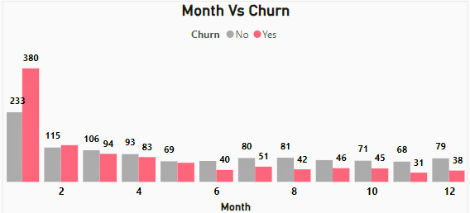
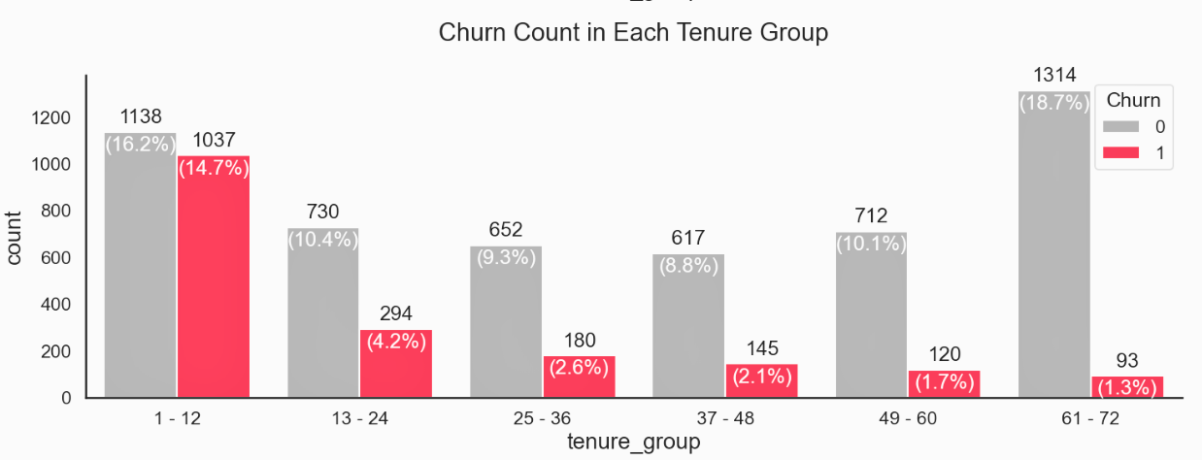
Exploratory Data Analysis (EDA)
If we analyze the churn rate over the course of one year by breaking it down into monthly fractions, we can observe that the first month has the highest churn rate, followed by the second, third, and fourth months
Tenure groups of 1-12 and 13–24 are churning more which can be intuitively understood from the fact that teens and early 20s customers are changing their telecom services more frequently and thus are not so loyal customers
Insight : New Customer : Customers who have recently joined the telecom service are more prone to churn. Perhaps they encountered issues or found a better deal elsewhere
Long-Term Loyal Customers: On the other hand, customers with longer tenure tend to stay. Their loyalty could be attributed to positive experiences, trust, or inertia like reliable Service, Excellent Customer support, Transparent Billing, Customized offer, Community engagement and consistency network upgrade
© 2021 Jigsaw Academy Education Pvt Ltd.
30

Slide 31
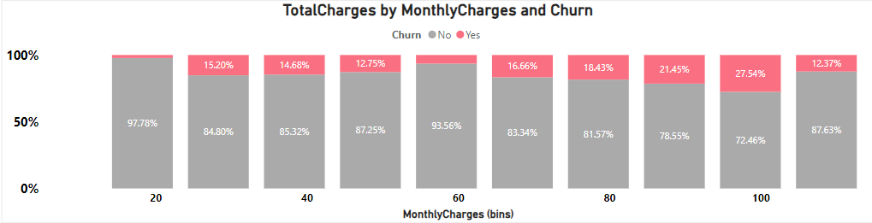
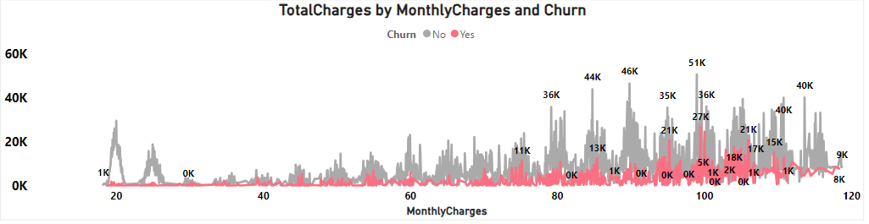
Bivariate Analysis -EDA
Monthly Charges and Total Charges Relationship:
Higher monthly charges often lead to shorter tenure as customers may find the cost unsustainable. Consequently, their total charges are lower due to the shorter duration. This combination of high monthly fees and short tenure contributes to a higher churn rate.
© 2021 Jigsaw Academy Education Pvt Ltd.
31

Slide 32

Exploratory Data Analysis (EDA)
Derived Insight
Monthly Charges: Customers with higher monthly charges may be more sensitive to price changes or service quality. If they perceive the value isn’t worth the cost, they might switch.
Total Charges: Higher total charges may correlate with increased churn. Customers who consistently pay more may be more likely to switch providers or seek better deals elsewhere.
Tenure
New Customer : Customers who have recently joined the telecom service are more prone to churn. Perhaps they encountered issues or found a better deal elsewhere.
Long-Term Loyal Customers: On the other hand, customers with longer tenure tend to stay. Their loyalty could be attributed to positive experiences, trust, or inertia like reliable Service, Excellent Customer support, Transparent Billing, Customized offer, Community engagement and consistency network upgrade
Factor like Gender and Mulitple line have no impact on the Churn rate
© 2021 Jigsaw Academy Education Pvt Ltd.
32

Slide 33
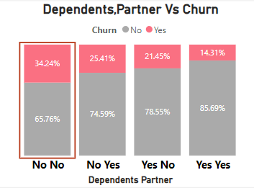
Bivariate Analysis -EDA
Findings :-
The absence of dependents and partners seems to be associated with higher churn rates.
Insight :
Lack of Emotional Support :
Individuals without dependents or partners may lack emotional support networks. When faced with service issues or dissatisfaction, they might not have someone to discuss it with or seek advice. As a result, they may be more likely to switch providers without hesitation.
Financial Constraints & Life changes : Single individuals often manage their finances independently as well as customer without dependents or partners might experience significant life changes (e.g., job relocation, lifestyle shifts, personal growth) more frequently.
© 2021 Jigsaw Academy Education Pvt Ltd.
33

Slide 34
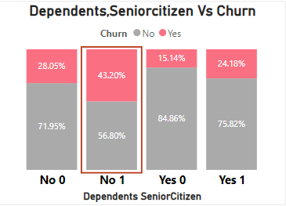
Bivariate Analysis -EDA
Finding :-
Customer who is no dependents and Senior citizen seems to be associated with higher churn rates.
Insight :
Customer without dependent have the grate financial independence more like to switch the provider if they find better offer and senior citizen often experience changeling need related to technology and communication and services . if the current provider doesn’t meet these evolve needs , may switch .
© 2021 Jigsaw Academy Education Pvt Ltd.
34

Slide 35
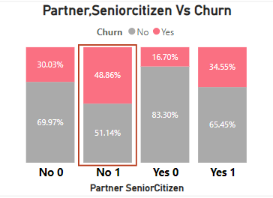
Bivariate Analysis -EDA
Finding :-
Customer who is no Partner and Seniorcitizen seems to be associated with higher churn rates.
Insight :
Senior citizen no partner mean less immediate support during health emergencies. Loneliness and lack of social support may lead to a higher likelihood of churn .
© 2021 Jigsaw Academy Education Pvt Ltd.
35

Slide 36
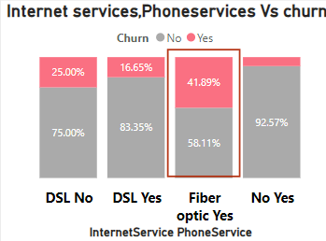
Bivariate Analysis -EDA
Findings
Customer who is having Fiber optics internet services as well as have phone services seems to be associated with higher churn rates .
Insight
Investigating potential service quality issues with fiber optic connections, including frequent outages and slow speeds. Assessing the competitiveness of fiber optic plans in terms of pricing. Evaluating the quality of customer support for fiber optic users.
Analyzing specific features of phone services such as call clarity and pricing to identify reasons for telco customer churn.
© 2021 Jigsaw Academy Education Pvt Ltd.
36

Slide 37
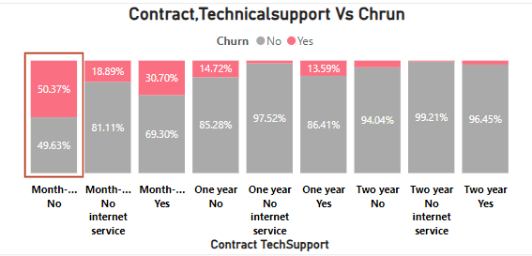
Bivariate Analysis -EDA
Finding :-
Customer who is having Fiber optics internet services as well as have phone services seems to be associated with higher churn rates .
Insight :-
Month-to-month contracts often lead to higher churn rates due to their lack of long-term commitment, susceptibility to pricing changes, and potential dissatisfaction with service; additionally, customers without access to tech support are more likely to churn due to unresolved technical issues, communication challenges, and the allure of competitor offers with better support options.
© 2021 Jigsaw Academy Education Pvt Ltd.
37

Slide 38
Features Pre-Processing
Raw data can be transformed into features that are suitable for machine learning models that process called feature engineering. The aim of feature engineering is to make a machine learning model for better learning and get more accuracy. In this article, we will label encoding for categorical variables that have two values, one hot encoding for categorical variables that have more than two values, and feature calling for numerical variables.
Label Encoding
Label encoding aims to convert categorical variables to numerical format. In this article, we will change categorical variables that have two values such as (Partner, Dependents, PhoneService, Churn, PaperlessBilling). Values of them just have Yes or No and we will change to 1 and 0 except gender is Female to 1 and Male to 0.
One Hot Encoding
Same with label encoding, one hot encoding also changes categorical variables to numerical variables. But, one hot encoding takes more than two values. One hot encoding creates a new binary integer (1 or 0) column for each level of the categorical variable. Categorical variables that have more than two values are (Multiple Lines, InternetService, OnlineSecurity, OnlineBackup, DeviceProtection, TechSupport, StreamingTV, Streaming Movies, Contract, Payment Method).
Numerical features using Min-Max Scaling
For the Numerical features like Monthly charges, total charges and Tenure we have applied technique Min-Max scaling to ensure numerical features are uniformly scales and contribute equally to the mode which range from 0 to 1
© 2021 Jigsaw Academy Education Pvt Ltd.
38

Slide 39
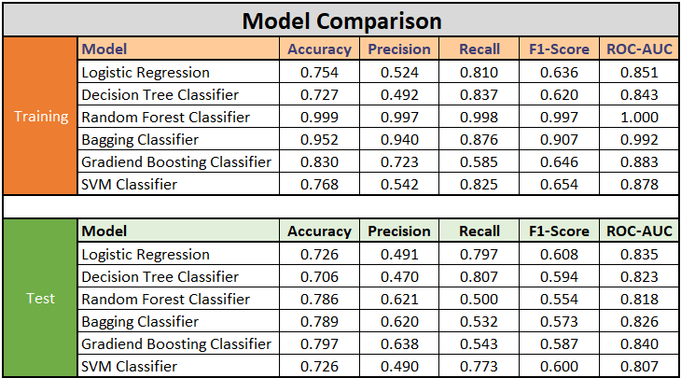
Train Test Split
Train test split is a process to validate the data set and simulate how the model performs with new data. In this article, we create 80% of train data and 20% of testing data. The “Churn” column we rename (the “y”) and the features column we rename (the “X”).
© 2021 Jigsaw Academy Education Pvt Ltd.
39

Slide 40
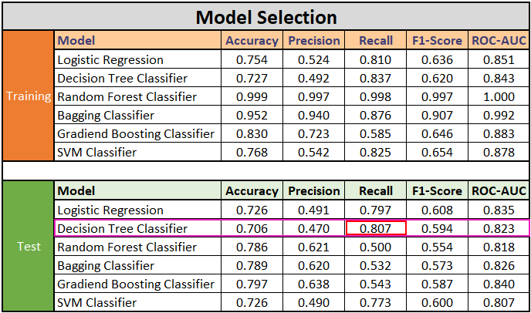

Model Selected
© 2021 Jigsaw Academy Education Pvt Ltd.
40

Slide 41




Decision Tree Model Selection
Model Selected
We have chosen the Decision Tree Classifier due to its high recall (0.807) in handling imbalanced data . The number of Non-Churn customer (Negative class) significantly outweigh the number of churn Customer (Positive Class) . The goal as to correctly identify as many churned customers as possible while minimizing false negatives (FN) – cases where actual churns are misclassified as non-churns.
The Decision Tree model excels in minimizing false negatives (FN), which is crucial for identifying potential churns
True Positives (TP): 302
True Negatives (TN): 692
False Positives (FP): 341
False Negatives (FN): 72
Recall (Sensitivity): Proportion of actual churned customers correctly identified.
Recall : TP/(TP+FN) = 0.807
72
Precision: Proportion of true positive predictions among all positive predictions
Precision :(TP/TP+FP) = 0.470
Accuracy: Overall correctness of predictions.
Accuracy :(TP+TN)/(TP+TN+FP+FN) = 0.706
F1-Score: Harmonic mean of precision and recall
F1 Score : 2 X Precision X Recall / Precision + Recall = 0.594
© 2021 Jigsaw Academy Education Pvt Ltd.
41

Slide 42
Decision Tree Model - Balancing the FP & FN
Trade-Off: Precision vs. Recall:
Precision: Measures how many of the predicted positive cases are actually true positives (TP). It focuses on minimizing false positives (FP).
Recall (Sensitivity): Measures how many of the actual positive cases (churns) are correctly identified. It focuses on minimizing false negatives (FN).
TN
FP
72
FN
TP
Why Minimizing FN Matters:
In churn prediction:
False Positives (FP): Predicting a customer will churn when they won’t. This may lead to unnecessary retention efforts or costs.
False Negatives (FN): Failing to predict a churn when it occurs. This can result in losing valuable customers.
Business Impact:
FNs are costlier: Missing a churned customer means losing potential revenue and the opportunity to retain them.
FPs can be managed: Overestimating churn can be addressed through targeted retention efforts.
True Positives (TP): 302
True Negatives (TN): 692
False Positives (FP): 341
False Negatives (FN): 72
© 2021 Jigsaw Academy Education Pvt Ltd.
42

Slide 43

ROC Curve for Decision Tree
The ROC curve is a graphical representation of a model’s performance across different thresholds for classification problems.It plots the True Positive Rate (TPR) against the False Positive Rate (FPR) as the threshold varies
The TPR (also known as recall or sensitivity) represents the proportion of actual positive cases correctly predicted by the model.
The FPR represents the proportion of actual negative cases incorrectly predicted as positive.
The ROC curve helps visualize the trade-off between sensitivity and specificity (1 - FPR).
Higher AUC values indicate better discrimination power of the model in distinguishing between positive and negative cases.
AUC is particularly useful when dealing with imbalanced datasets (e.g., more non-churned customers than churned ones).
AUC: Area under the ROC curve
© 2021 Jigsaw Academy Education Pvt Ltd.
43

Slide 44

Feature Important for Decision Tree
1.Contract Type (Month-to-Month): The type of contract significantly impacts churn. Customers with month-to-month contracts are more likely to churn. This feature has the highest importance at 65.8%
2.Internet Service (Fiber Optic): Customers using fiber optic internet service are also more prone to churn. It contributes 10.5% to the model's decision.
3.Tenure: The length of time a customer has been with the telco affects churn. Longer tenure tends to reduce churn. This feature accounts for 10.1%of the model's prediction.
4.Monthly Charges: Higher monthly charges may lead to churn. This feature has a smaller impact at 4.1%.
5.Payment Method (Electronic Check): Customers using electronic checks for payment are more likely to churn. It contributes 2.4% to the model.
6.Tech Support (No): Lack of tech support increases churn. This feature has an impact of 1.96%.
7.Contract Type (Two-Year): Customers with two-year contracts end to stay longer, reducing churn. It contributes 1.5%
8. Total Charges: The total amount charged over time affects churn. It has a smaller impact at 1.2%.
9.Contract Type (One-Year) Customers with one-year contracts fall in between month-to-month and two-year contracts. It contributes 1.1%
© 2021 Jigsaw Academy Education Pvt Ltd.
44

Slide 45

Important Feature - Decision Tree
Insights and Understanding:
Focus on Contract Type: The month-to-month contract is a critical factor. Consider offering incentives or discounts to encourage customers to switch to longer-term contracts.
Improve Fiber Optic Service: Address issues related to fiber optic internet service to retain those customers.
Enhance Tech Support: Providing better tech support can reduce churn.
Payment Methods: Encourage other payment methods besides electronic checks.
Customer Education: Educate customers about the benefits of longer-term contracts.
Note: these insights are based on the model's predictions, and real-world factors may vary.
© 2021 Jigsaw Academy Education Pvt Ltd.
45

Slide 46

Reducing Revenue Losses and Enhancing Customer Retention
© 2021 Jigsaw Academy Education Pvt Ltd.
46

Slide 47


Model deployment Demo in Hugging face & Streamlit Apps
47

Slide 48

Thank
you!
© 2021 Jigsaw Academy Education Pvt Ltd.

